Slide 1
Software Testing and Quality Assurance
Theory and Practice
Chapter 4
Control Flow Testing
Notes:
Handouts
------------------------------------------------------------------
------------------------------------------------------------------
-------------------------------------------------------------------
--------------------------------------------------------------------

Slide 2
Outline of the Chapter
Basic Idea
Outline of Control Flow Testing
Control Flow Graph
Paths in a Control Flow Graph
Path Selection Criteria
Generating Test Input
Containing Infeasible Paths
Summary
Notes:
Handouts

Slide 3
Basic Idea
Two kinds of basic program statements:
  Assignment statements (Ex. x = 2*y; )
  Conditional statements (Ex. if(), for(), while(), …)
Control flow
  Successive execution of program statements is viewed as flow of control.
  Conditional statements alter the default flow.
Program path
  A program path is a sequence of statements from entry to exit.
  There can be a large number of paths in a program.
  There is an (input, expected output) pair for each path.
  Executing a path requires invoking the program unit with the right test input.
  Paths are chosen by using the concepts of path selection criteria.
Tools: Automatically generate test inputs from program paths.
Notes:
Handouts

Slide 4
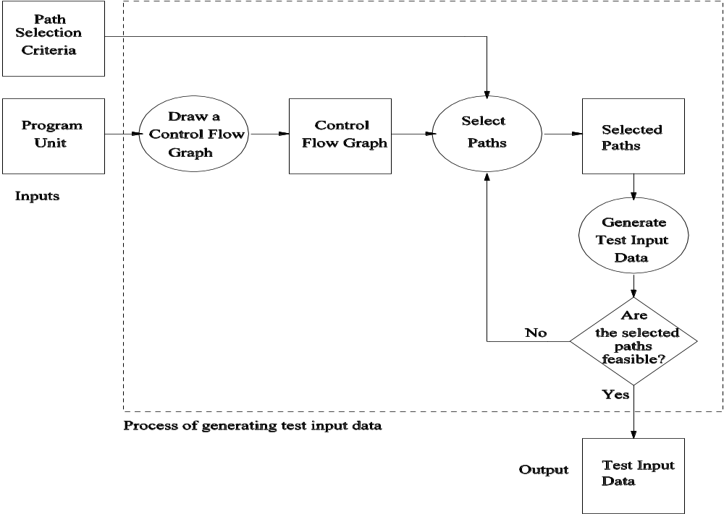
Outline of Control Flow Testing
Figure 4.1: The process of generating test input data for control flow testing.
Notes:
Handouts

Slide 5
Outline of Control Flow Testing
Inputs to the test generation process
  Source code
  Path selection criteria: statement, branch, …
Generation of control flow graph (CFG)
  A CFG is a graphical representation of a program unit.
  Compilers are modified to produce CFGs. (You can draw one by hand.)
Selection of paths
  Enough entry/exit paths are selected to satisfy path selection criteria.
Generation of test input data
  Two kinds of paths
    Executable path: There exists input so that the path is executed.
    Infeasible path: There is no input to execute the path.
  Solve the path conditions to produce test input for each path.
Notes:
Handouts

Slide 6
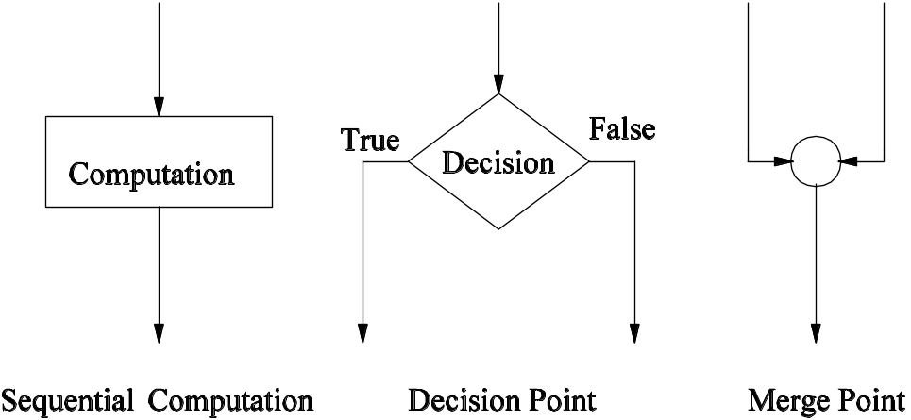
Control Flow Graph
Symbols in a CFG
Figure 4.2: Symbols in a control flow graph
Notes:
Handouts

Slide 7
Control Flow Graph
Example code: openfiles()
FILE *fptr1, *fptr2, *fptr3; /* These are global variables. */
int openfiles(){
/*
This function tries to open files "file1", "file2", and "file3"
for read access, and returns the number of files successfully
opened. The file pointers of the opened files are put in the
global variables.
*/
int i = 0;
if(
((( fptr1 = fopen("file1", "r")) != NULL) && (i++) && (0)) ||
((( fptr2 = fopen("file2", "r")) != NULL) && (i++) && (0)) ||
((( fptr3 = fopen("file3", "r")) != NULL) && (i++))
);
return(i);
}
Figure 4.3: A function to open three files.
Notes:
Handouts

Slide 8
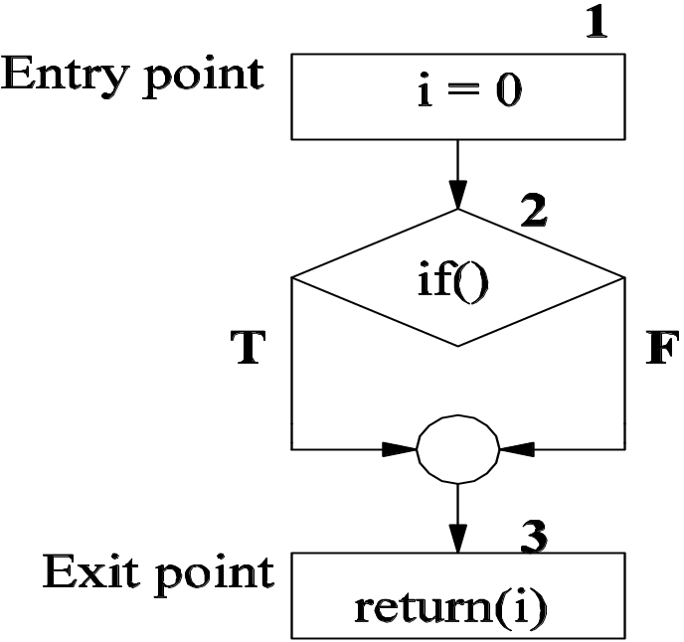
Control Flow Graph
Figure 4.4: A high-level CFG representation of openfiles().
Notes:
Handouts

Slide 9
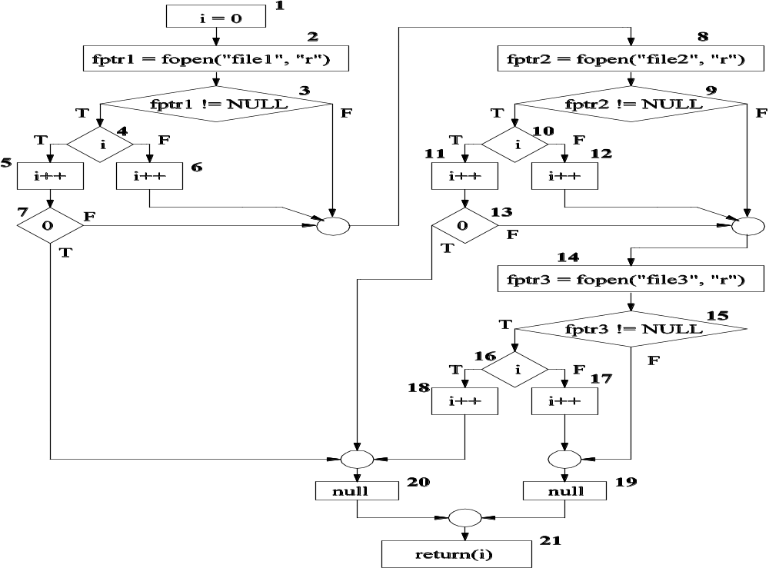
Control Flow Graph
Figure 4.5: A detailed CFG representation of openfiles().
Notes:
Handouts

Slide 10
Control Flow Graph
Example code: ReturnAverage()
public static double ReturnAverage(int value[], int AS, int MIN, int MAX){
/* Function: ReturnAverage Computes the average of all those numbers in the input array in
the positive range [MIN, MAX]. The maximum size of the array is AS. But, the array size
could be smaller than AS in which case the end of input is represented by -999. */
int i, ti, tv, sum;
double av;
i = 0; ti = 0; tv = 0; sum = 0;
while (ti < AS && value[i] != -999) {
ti++;
if (value[i] >= MIN && value[i] <= MAX) {
tv++;
sum = sum + value[i];
}
i++;
}
if (tv > 0)
av = (double)sum/tv;
else
av = (double) -999;
return (av);
}
Figure 4.6: A function to compute the average of selected integers in an array.
Notes:
Handouts

Slide 11
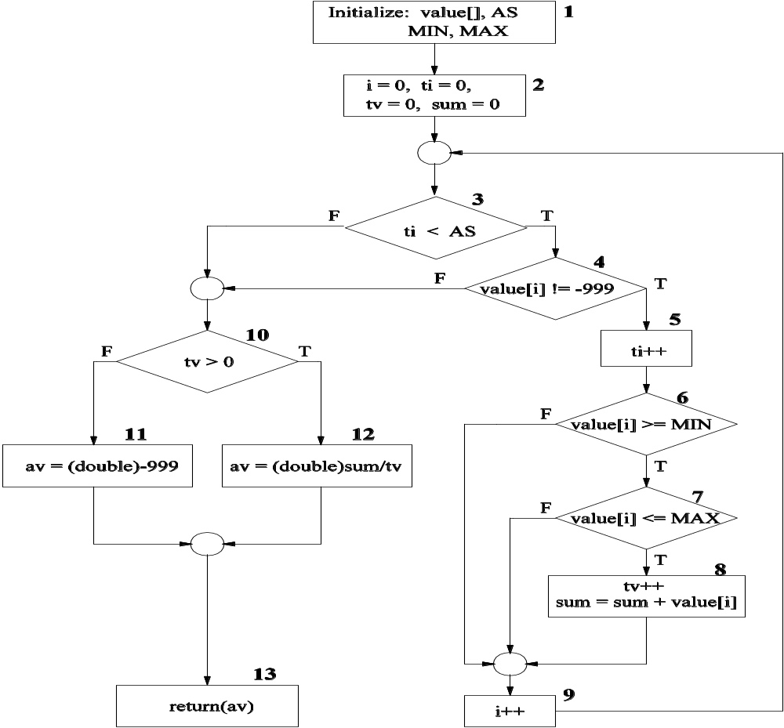
Control Flow Graph
Figure 4.7: A CFG representation of ReturnAverage().
Notes:
Handouts

Slide 12
Paths in a Control Flow Graph
A few paths in Figure 4.7. (Table 4.1)
  Path 1: 1-2-3(F)-10(T)-12-13
  Path 2: 1-2-3(F)-10(F)-11-13
  Path 3: 1-2-3(T)-4(T)-5-6(T)-7(T)-8-9-3(F)-10(T)-12-13
  Path 4: 1-2-3(T)-4(T)-5-6-7(T)-8-9-3(T)-4(T)-5-6(T)-7(T)-8-9-3(F)-10(T)-12- 13
Notes:
Handouts

Slide 13
Path Selection Criteria
Program paths are selectively executed.
Question: What paths do I select for testing?
The concept of path selection criteria is used to answer the question.
Advantages of selecting paths based on defined criteria:
  Ensure that all program constructs are executed at least once.
  Repeated selection of the same path is avoided.
  One can easily identify what features have been tested and what not.
Path selection criteria
  Select all paths.
  Select paths to achieve complete statement coverage.
  Select paths to achieve complete branch coverage.
  Select paths to achieve predicate coverage.
Notes:
Handouts

Slide 14
Path Selection Criteria
All-path coverage criterion: Select all the paths in the program unit under consideration.
  The openfiles() unit has 25+ paths.
  Table 4.2: The input domain of openfiles()
  Selecting all the inputs will exercise all the program paths.
Existence of “file1” | Existence of “file2” | Existence of “file3”
No | No | No
No | No | Yes
No | Yes | No
No | Yes | Yes
Yes | No | No
Yes | No | Yes
Yes | Yes | No
Yes | Yes | Yes
Notes:
Handouts

Slide 15
Path Selection Criteria
Table 4.3 Inputs and paths in openfiles()
Input | Path
<No, No, No> | 1-2-3(F)-8-9(F)-14-15(F)-19-21
<Yes, No, No> | 1-2-3(T)-4(F)-6-8-9(F)-14-15(F)-19-21
<Yes, Yes, Yes> | 1-2-3(T)-4(F)-6-8-9(T)-10(T)-11-13(F)-14- 15(T) -16(T)-18-20-21
Notes:
Handouts

Slide 16
Path Selection Criteria
Statement coverage criterion
  Statement coverage means executing individual program statements and observing the output.
  100% statement coverage means all the statements have been executed at least once.
    Cover all assignment statements.
    Cover all conditional statements.
  Less than 100% statement coverage is unacceptable.
  Table 4.4: Paths for statement coverage of the CFG of Figure 4.7.
SCPath1 | 1-2-3(F)-10(F)-11-13
SCPath2 | 1-2-3(T)-4(T)-5-6(T)-7(T)-8-9-3(F)-10(T)-12-13
Notes:
Handouts

Slide 17
Path Selection Criteria
Branch coverage criterion
  A branch is an outgoing edge from a node in a CFG.
    A condition node has two outgoing branches – corresponding to the True and False values of the condition.
  Covering a branch means executing a path that contains the branch.
  100% branch coverage means selecting a set of paths such that each branch is included on some path.
Notes:
Handouts

Slide 18
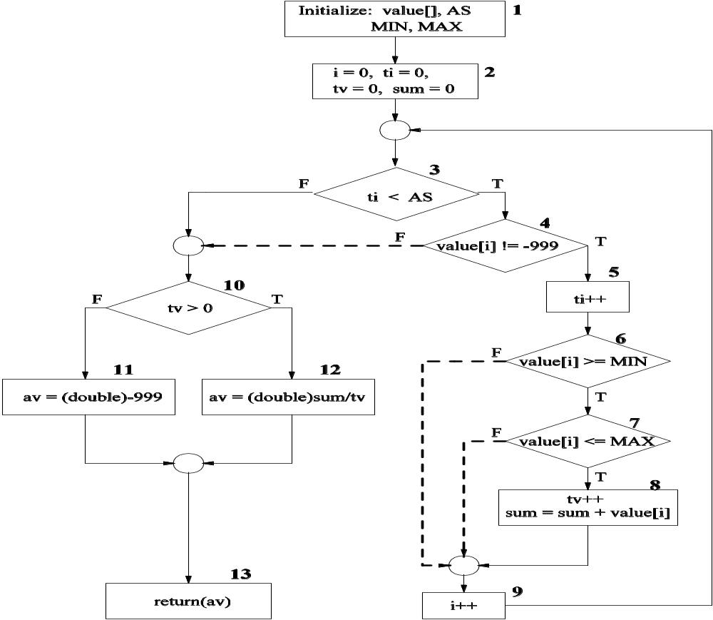
Path Selection Criteria
Figure 4.8: The dotted arrows represent the branches not covered
by the statement covering in Table 4.4.
Notes:
Handouts

Slide 19
Path Selection Criteria
Branch coverage criterion
  A branch is an outgoing branch (edge) from a node in a CFG.
    A condition node has two outgoing branches – corresponding to the True and False values of the condition.
  Covering a branch means executing a path that contains the branch.
  100% branch coverage means selecting a set of paths such that each branch is included on some path.
  Table 4.5: Paths for branch coverage of the flow graph of Figure 4.7.
BCPath 1 | 1-2-3(F)-10(F)-11-13
BCPath 2 | 1-2-3(T)-4(T)-5-6(T)-7(T)-8-9-3(F)-10(T)-12-13
BCPath 3 | 1-2-3(T)-4(F)-10(F)-11-13
BCPath 4 | 1-2-3(T)-4(T)-5-6(F)-9-3(F)-10(F)-11-13
BCPath 5 | 1-2-3(T)-4(T)-5-6(T)-7(F)-9-3(F)-10(F)-11-13
Notes:
Handouts

Slide 20
Path Selection Criteria
Predicate coverage criterion
  If all possible combinations of truth values of the conditions affecting a path have been explored under some tests, then we say that predicate coverage has been achieved.
Notes:
Handouts

Slide 21
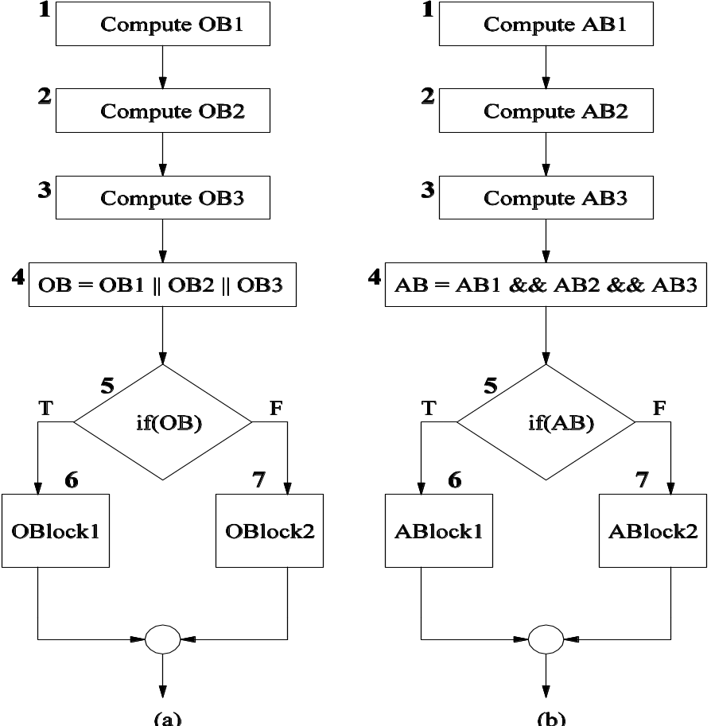
Path Selection Criteria
Figure 4.9: Partial control flow graph with (a) OR operation and (b) AND operation.
Notes:
Handouts

Slide 22
Generating Test Input
Having identified a path, a key question is how to make the path execute, if possible.
  Generate input data that satisfy all the conditions on the path.
Key concepts in generating test input data
  Input vector
  Predicate
  Path condition
  Predicate interpretation
  Path predicate expression
  Generating test input from path predicate expression
Notes:
Handouts

Slide 23
Generating Test Input
Input vector
  An input vector is a collection of all data entities read by the routine whose values must be fixed prior to entering the routine.
  Members of an input vector can be as follows.
    Input arguments to the routine
    Global variables and constants
    Files
    Contents of registers (in Assembly language programming)
    Network connections
    Timers
  Example: An input vector for openfiles() consists of individual presence or absence of the files “files1,” “file2,” and “file3.”
  Example: The input vector of ReturnAverega() shown in Figure 4.6 is <value[], AS, MIN, MAX>.
Notes:
Handouts

Slide 24
Generating Test Input
Predicate
  A predicate is a logical function evaluated at a decision point.
  Example: ti < AS is a predicate in node 3 of Figure 4.7.
  Example: The construct OB is a predicate in node 5 in Figure 4.9.
Path predicate
  A path predicate is the set of predicates associated with a path.
  Figure 4.10: An example path from Fig. 4.7:
    1-2-3(T)-4(T)-5-6(T)-7(T)-8-9-3(F)-10(T)-12-13.
  Figure 4.11: The path predicate for the path shown in Figure 4.10.
    ti < AS ≡ True
    value[i] != -999 ≡ True
    value[i] >= MIN ≡ True
    value[i] <= MAX ≡ True
    ti < AS ≡ False
    tv > 0 ≡ True
Notes:
Handouts

Slide 25
Generating Test Input
Predicate interpretation
  A path predicate may contain local variables.
  Example: <i, ti, tv> in Figure 4.11 are local variables.
  Local variables play no role in selecting inputs that force a path to execute.
  Local variables can be eliminated by a process called symbolic execution.
  Predicate interpretation is defined as the process of
      symbolically substituting operations along a path in order to express the predicate solely in terms of the input vector and a constant vector.
  A predicate may have different interpretations depending on how control reaches the predicate.
Notes:
Handouts

Slide 26
Generating Test Input
Path predicate expression
  An interpreted path predicate is called a path predicate expression.
  A path predicate expression has the following attributes.
    It is void of local variables.
    It is a set of constraints in terms of the input vector, and, maybe, constants.
    Path forcing inputs can be generated by solving the constraints.
    If a path predicate expression has no solution, the path is infeasible.
  Figure 4.13: Path predicate expression for the path shown in Figure 4.10.
    0 < AS ≡ True …… (1)
    value[0] != -999 ≡ True …… (2)
    value[0] >= MIN ≡ True …… (3)
    value[0] <= MAX ≡ True …… (4)
    1 < AS ≡ False …… (5)
    1 > 0 ≡ True …… (6)
Notes:
Handouts

Slide 27
Generating Test Input
Path predicate expression
  An example of infeasible path
  Figure 4.14: Another example of path from Figure 4.7.
    1-2-3(T)-4(F)-10(T)-12-13
  Figure 4.15: Path predicate expression for the path shown in Figure 4.14.
    0 < AS ≡ True …… (1)
    value[0] != -999 ≡ True …… (2)
    0 > 0 ≡ True …… (3)
Notes:
Handouts

Slide 28
Generating Test Input
Generating input data from a path predicate expression
  Consider the path predicate expression of Figure 4.13 (reproduced below.)
    0 < AS ≡ True …… (1)
    value[0] != -999 ≡ True …… (2)
    value[0] >= MIN ≡ True …… (3)
    value[0] <= MAX ≡ True …… (4)
    1 < AS ≡ False …… (5)
    1 > 0 ≡ True …… (6)
  One can solve the above equations to obtain the following test input data
      AS = 1
      MIN = 25
      MAX = 35
      Value[0] = 30
  Note: The above set is not unique.
Notes:
Handouts

Slide 29
Containing Infeasible Paths
A program unit may contain a large number of paths.
  Path selection becomes a problem. Some selected paths may be infeasible.
  Apply a path selection strategy:
    Select as many short paths as possible.
    Choose longer paths.
  There are efforts to write code with fewer/no infeasible paths.
Notes:
Handouts

Slide 30
Summary
Control flow is a fundamental concept in program execution.
A program path is an instance of execution of a program unit.
Select a set of paths by considering path selection criteria.
    Statement coverage
    Branch coverage
    Predicate coverage
    All paths
From source code, derive a CFG (compilers are modified for this.)
Select paths from a CFG based on path selection criteria.
Extract path predicates from each path.
Solve the path predicate expression to generate test input data.
There are two kinds of paths.
    feasible
    infeasible
Notes:
Handouts

